Slide 1

Machine Learning Project: Predicting Customer Creditworthiness
This presentation outlines a machine learning project focused on predicting customer creditworthiness. The goal is to accurately assess risk. This enables better lending decisions. We will cover each stage. From data preparation to model deployment. Join us as we explore this project.

Slide 2
Project Introduction
Project Goal
Impact
Significance
Build a machine learning model to predict customer credit scores as Poor, Standard, or Good.
Assist financial institutions in making better lending decisions by predicting borrower creditworthiness.
A credit score is a key factor in loan approval and interest rate determination.
Early and accurate prediction of a customer's credit score helps manage lending risks.

Slide 3

Project Objectives
1
Data Collection
Gather comprehensive customer data from various sources.
2
Model Training
Train the model using a diverse dataset to ensure accuracy.
3
Performance Tuning
Optimize model parameters to achieve the highest possible performance.
4
Deployment
Deploy the model in a production environment for real-time predictions.

Slide 4





Data Preparation
Collection
Cleaning
Transformation
Normalization
Source: CSV files containing training and test data.
Handling missing values by replacing numerical columns with median values and categorical columns with mode values.
Encoding categorical variables using Label Encoding.
Scaling data using StandardScaler for consistent model input.

Slide 5




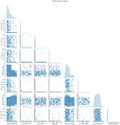
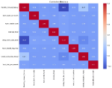
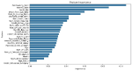



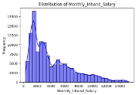
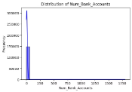
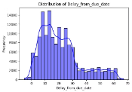



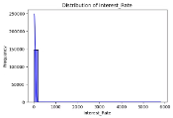
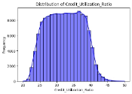
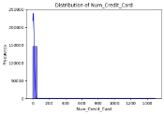
Exploratory Data Analysis
Visualization
Pattern Identification
Insight Generation
Create charts to understand data distribution.
Identify trends and correlations.
Generate insights to inform feature engineering.
Distribution of monthly income
Distribution of num of bank a/c
Distribution of delay
Distribution of interest rate
Distribution of credit utilization ratio
Distribution of num of credit cards

Slide 6




Feature Engineering
Feature engineering enhances model accuracy through a systematic process:
Selection
Creation
Transformation
Encoding
Select the most relevant features
Create new features from existing data
Transform features for better model performance
Encode categorical variables
Engineered Features:
Debt-to-Income Ratio
Payment Delay Ratio
Age Group Categorization
Credit Utilization Category
Outstanding Debt / Annual Income
Number of Delayed Payments / Number of Loans
Young, Adult, Middle-Aged, Senior
Low, Medium, High
This makes data suitable for modeling.

Slide 7





Model Selection & Evaluation
Five machine learning models were evaluated using multiple performance metrics to determine the most effective approach for credit prediction.
Random Forest: Top Performer
Leading performance with 89.76% accuracy and impressive balanced metrics (Precision: 88%, Recall: 90%, F1-score: 89%).
XGBoost: Strong Contender
Nearly matching the leader with 88.92% accuracy and robust metrics (Precision: 87%, Recall: 89%, F1-score: 88%).
Decision Tree: Mid-Range Option
Solid performance at 82.12% accuracy (Precision: 81%, Recall: 83%, F1-score: 82%), though potential overfitting concerns exist.
K-Nearest Neighbors: Basic Approach
Moderate results with 75.45% accuracy (Precision: 74%, Recall: 75%, F1-score: 74.5%), offering computational efficiency.
Logistic Regression: Baseline Model
Basic performance at 72.34% accuracy (Precision: 70%, Recall: 69%, F1-score: 69.5%), but provides high interpretability.

Slide 8
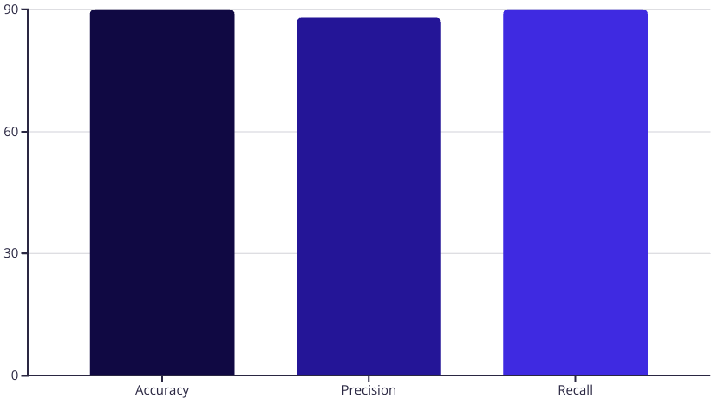
Best Model
The Random Forest model outperforms others with superior metrics across all evaluation criteria, making it the optimal choice for our creditworthiness prediction task.
Key Insights
Highest overall performance with 90% accuracy score
Strong positive prediction precision at 88%
Excellent sensitivity with 90% recall score
The model demonstrates exceptional balance between precision and recall, confirming its robust performance in predicting both positive and negative cases.

Slide 9




Model Development Process
Feature Processing
Model Training
Model Selection
Evaluation
Transform and encode features to prepare data for modeling
Train multiple models including Random Forest, XGBoost, and Logistic Regression
Compare performance metrics to select the best performing model
Assess model using accuracy, precision, recall and F1-score
The model development pipeline ensures systematic evaluation of different algorithms to identify the most effective solution for credit prediction.
Notes:
This slide bridges the gap between feature engineering and model selection, showing the complete development lifecycle.

Slide 10

Model Deployment
Fast API
Deploy as a fast API for real-time access.
Integration
Integrate with existing systems and applications.
Monitoring
Monitor model performance in production.
Model deployment enables real-time predictions. Deploy the model as a FAST API. Integrate it with existing systems. Monitor the model to ensure performance. This delivers ongoing value and support.

Slide 11



Conclusion
1
Insightful predictions
2
Efficient lending decisions
3
Reduced financial risk
This project successfully developed a creditworthiness prediction model. The model provides insightful predictions. This enables efficient lending decisions. It helps in reducing financial risk.

Slide 12

Future Improvements
Data Enrichment
Advanced Algorithms
Incorporate additional data sources to enhance accuracy.
Experiment with deep learning models.
Real-time Analysis
Implement real-time data processing capabilities.

